Slide 1

Import And Export Report of India PRANAVI PULIPAKA

Slide 2
Objectives
To analyse total import to India year wise
To analyse total export from India year wise
To find the countries that account to the largest total trade
To find the countries which are the largest exporters from India
To find the countries which are the largest importers to India
To analyse import vs Export for Top 10 Countries with highest total trade

Slide 3
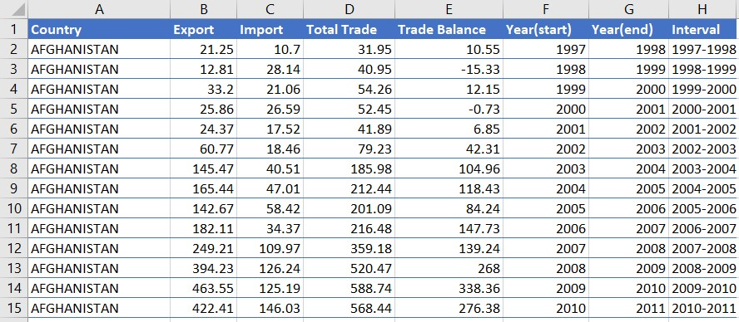
The Data!

Slide 4
Data Dictionary
Dataset has a list of all the countries to which India exported and imported from 1997 to 2022
The dataset has 7 columns and 5201 rows
Total Trade = Import + Export
Trade Balance = Export – Import

Slide 5
To analyse total import to India year wise

Slide 6
To analyse total export from India year wise

Slide 7
Import Vs Export Year wise

Slide 8
Total Trade Vs Trade Balance Of top 10 Countries

Slide 9
Import Vs Export Country wise

Slide 10
4,70,9080.55$
6,94,4485.08$
Total revenue generated from Exports
Total money spent on Imports

Slide 11
Insights
Countries like China , United Arab Amirates account for the largest importers to India.
Countries like the USA, United Arab Amirates account for the largest exporters from India.
India shows a negative trade balance over the years from 1997 to 2022 which suggests import has always been more than export.
Countries like the USA, United Arab Amirates ,China, Saudi Arabia, Switzerland are involved with the largest total trade with India.

Slide 12
Bibliography
https://www.kaggle.com/datasets/ramjasmaurya/exports-and-imports-of-india19972022

Slide 13
Thank You!

